Slide 1
Machine Learning
“A field of study that gives computers the capability to learn without being explicitly programmed."

Slide 2
REGRESSION

Slide 3
Recap
Regression is a statistical measurement used in finance, investing, and other disciplines that attempts to determine the strength of the relationship between one dependent variable and a series of other changing variables or independent variable

Slide 4
Logistic Regression
In statistics, the logistic model is used to model the probability of a certain class or event existing such as pass/fail, win/lose, alive/dead or healthy/sick. This can be extended to model several classes of events such as determining whether an image contains a cat, dog, lion, etc

Slide 5
Logistic Regression cont’d
Based on the number of categories, Logistic regression can be classified as:
Binomial: Target variable can have only 2 possible types: “0” or “1” which may represent “win” vs “loss”, “pass” vs “fail”, “dead” vs “alive”, etc.
Multinomial: Target variable can have 3 or more possible types which are not ordered(i.e. types have no quantitative significance) like “disease A” vs “disease B” vs “disease C”.
Ordinal: It deals with target variables with ordered categories. For example, a test score can be categorized as:“very poor”, “poor”, “good”, “very good”. Here, each category can be given a score like 0, 1, 2, 3.

Slide 6
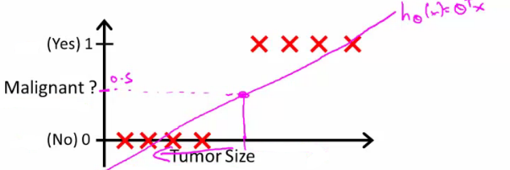
Start with binary class problems
How do we develop a classification algorithm?
Tumour size vs malignancy (0 or 1)
We could use linear regression
Then threshold the classifier output (i.e. anything over some value is yes, else no)
In our example below linear regression with thresholding seems to work

Slide 7
Binary class problems cont’d
From above, we can see that this does a reasonable job of stratifying the data points into one of two classes
But what if we had a single Yes with a very small tumour?
This would lead to classifying all the existing YESes as Nos.
Another issue with linear regression:
We know Y is 0 or 1, but
Hypothesis can give values large than 1 or less than 0.
So, logistic regression generates a value where is always either 0 or 1
Logistic regression is a classification algorithm - don't be confused

Slide 8


Hypothesis representation
We want our classifier to output values between 0 and 1
When using linear regression we did h_{θ}(x) = (θ^{T} x)
For classification hypothesis representation we do h_{θ}(x) = g((θ^{T} x))
Where we define g(z)
z is a real number
This is the sigmoid function, or the logistic function
If we combine these equations we can write out the hypothesis as

Slide 9
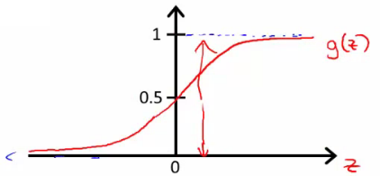
How does the sigmoid function look like?
Crosses 0.5 at the origin, then flattens out
Asymptotes at 0 and 1

Slide 10
Interpreting hypothesis output
When our hypothesis (h_{θ}(x)) outputs a number, we treat that value as the probability that y = 1 on input x.
For example:
If X is a feature vector with x₀ = 1 and x₁ = tumourSize
h_{θ}(x) = 0.7 tells a patient they have a 70% chance of a tumor being malignant
h_{θ}(x) = P(y=1|x ; θ)
What does this mean?
Probability that y=1, given x, parameterized by θ
Since this is a binary classification task we know that y = 0 or 1. So, the following must be true:
P(y=1|x ; θ) + P(y=0|x ; θ) = 1
P(y=0|x ; θ) = 1 - P(y=1|x ; θ)

Slide 11
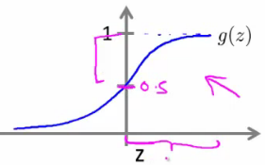
Decision boundary
This gives a better sense of what the hypothesis function is computing. One way of using the sigmoid function is when the probability of y being 1 is greater than 0.5 then we can predict y = 1, else we predict y = 0.
When is it exactly that h_{θ}(x) is greater than 0.5? Look at sigmoid function
g(z) is greater than or equal to 0.5 when z is greater than or equal to 0

Slide 12
Decision boundary cont’d
So, if z is positive, g(z), with z = (θ^{T} x) is greater than 0.5. What we've shown is that the hypothesis predicts y = 1 when θ^{T} x >= 0
The corollary of that when θ^{T} x <= 0 then the hypothesis predicts y = 0

Slide 13
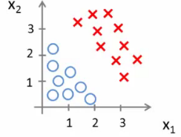
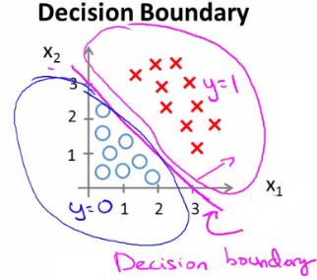
Practical example
Consider,
h_{θ}(x) = g(θ₀ + θ₁x₁ + θ₂x₂). Let θ₀ = -3, θ₁ = 1, and θ₂ = 1
Our parameter vector is a column vector with the above values
So, θ^{T} is a row vector = [-3,1,1]
The z here becomes θ^{T} x
We predict "y = 1" if
-3x₀ + 1x₁ + 1x₂ >= 0
-3 + x₁ + x₂ >= 0
We can also re-write this as
If (x₁ + x₂ >= 3) then we predict y = 1
If we plot
x₁ + x₂ = 3 we graphically plot our decision boundary

Slide 14
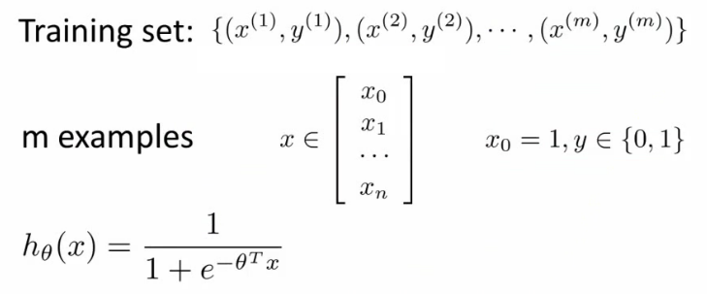


Cost function for logistic regression
Linear regression uses the following function to determine θ

Slide 15
Analysis
If we use this function for logistic regression, then this is a non-convex function for parameter optimization.
What do we mean by non convex?
We have some function - J(θ) - for determining the parameters
Our hypothesis function has non-linearity (a sigmoid function of h_{θ}(x) ) which is a complicated non-linear function
If you take h_{θ}(x) and plug it into the cost function, and them plug the cost function into J(θ) and plot J(θ), we find many local optimum -> non convex function

Slide 16
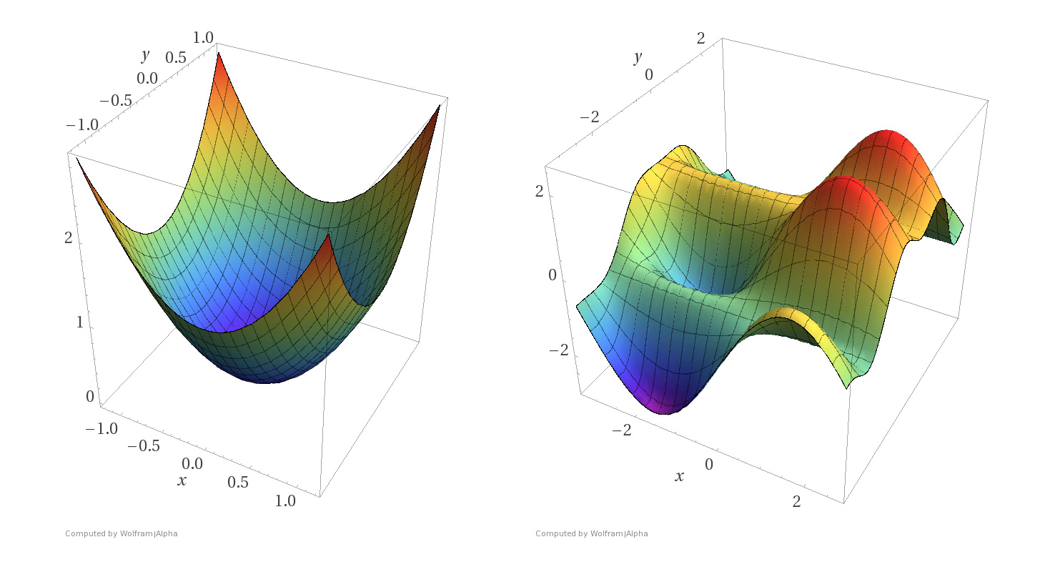
Why is this a problem?
Lots of local minima mean gradient descent may not find the global optimum - may get stuck in a global minimum
We would like a convex function so if you run gradient descent you converge to a global minimum

Slide 17

A convex logistic regression cost function
To get around this we need a different, convex cost function which means we can apply gradient descent
The above two functions can be compressed into a single function i.e.

Slide 18
Let’s write some codes

